Slide 1
Python Course for Physicists (And everyone else!) Chunk 12b: Final Words Day 1
By Jonathan Bollig
10.10.2025

Slide 2
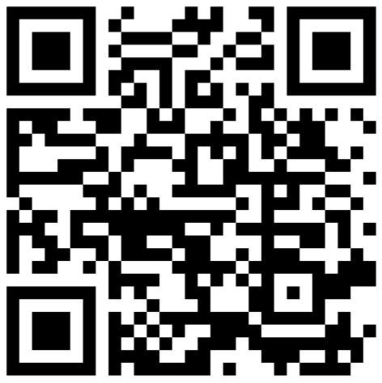
Feedback
https://vibes.fh-muenster.de/apps/live-votings/S83C1/

Slide 3
See you not tomorrow 9:30 ☹ But see you around in Jena ☺

